Slide 1

https://www.uni-goettingen.de/en/48115.html
Unless I explicitly state otherwise, images and cartoons are created using ChatGPT.
You may use this material free of charge under the terms of the CC BY license. This requires that you provide appropriate attribution to the author: W. Link, University of Goettingen, Germany.
In a few cases, individual images, photographs, or similar material may be subject to a more restrictive Creative Commons license. Where this applies, it is explicitly indicated, and you must comply with the stated license terms for those items.
Please check the license information carefully before reuse. Responsibility for complying with the applicable license terms rests entirely with you.
UNPLAB-CorrTraits_Ch-3[IndexSel] Selection based on an Index
1

Slide 2
Sequential Number: #34
UNPLAB-CorrTraits_Ch-3[IndexSel]
This symbol usually indicates that a page is rather important
2

Slide 3
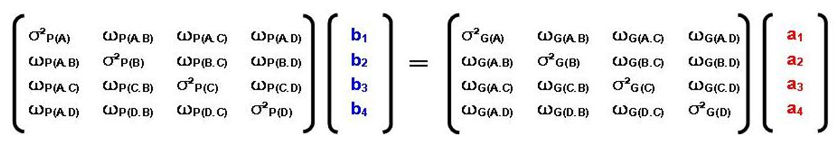
You already know: Population Genetics, 12 Chapters. Heritability and GxE, 6 Chapters. Breeding Method, 13 Chapters. Concept of Direct Selection vs. Indirect Selection. Phenotypic versus genetic correlation.
Still awaiting - after ‘Correlated Traits’ - is Quantitative Genetics, 14 Chapters.
Keywords of this chapter: Linear selection index, independent culling, tandem selection, Index Selection, Optimum Index, Phenotypic and genetic variance-covariance matrix
Algebra as introduced in this chapter:
3

Slide 4
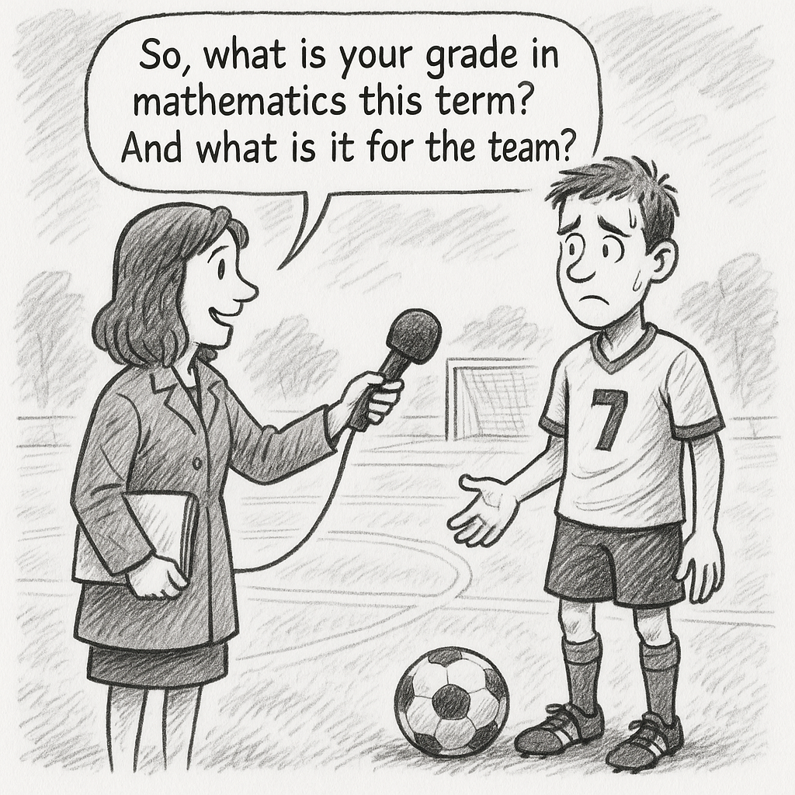
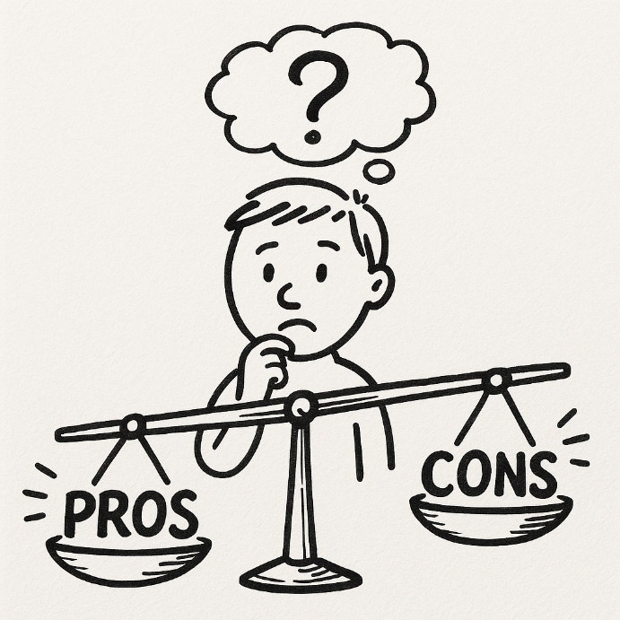
Weigh up advantages and dis-advantages so that the resulting selection is optimal.
4

Slide 5
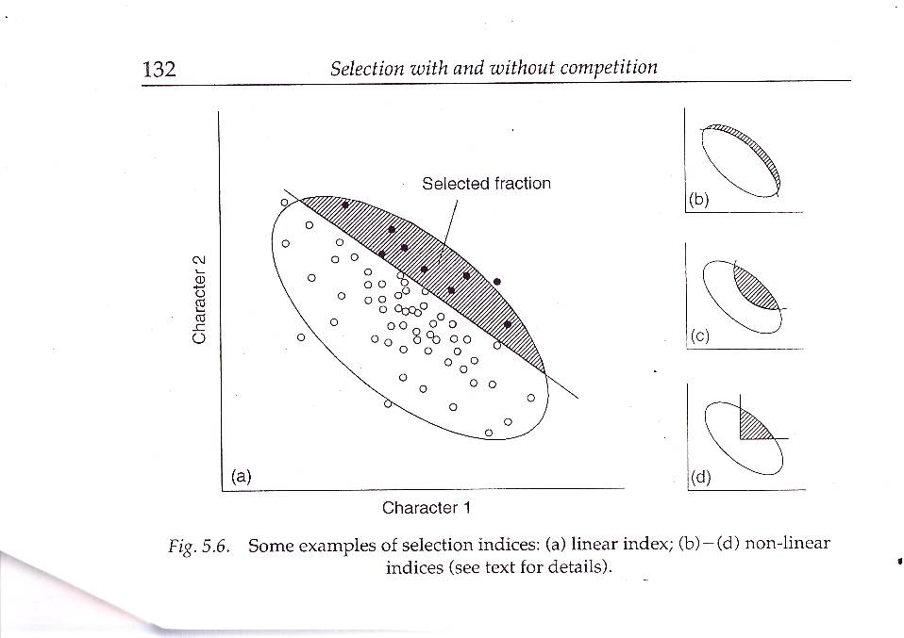
As we test candidate genotypes (field, chamber, lab), we collect data (scores, measure-ments) for several traits. We rank candidates based on several trait simultaneously.
Not easy to have a superior grade point average in Mathematics and in Football.
Inasmuch will a superior mark here compensate for an inferior mark there?
To rank candidates for several traits, a useful approach is to sum the weighted trait expression data. This way one constructs a new, synthetic trait, joining all others: valuation according to weighted average (‘grade point average’, GPA in the cartoon). We know this weighing approach from school reports, for example, when for the average grade, Math is weighted more heavily than, say, Sport or Music.
In simple cases, such weighted sum or weighted average represents a so-called Linear Index.
ISBN 0412753901
Selected fraction
Second Trait
First Trait
Linear Selection Index
5

Slide 6
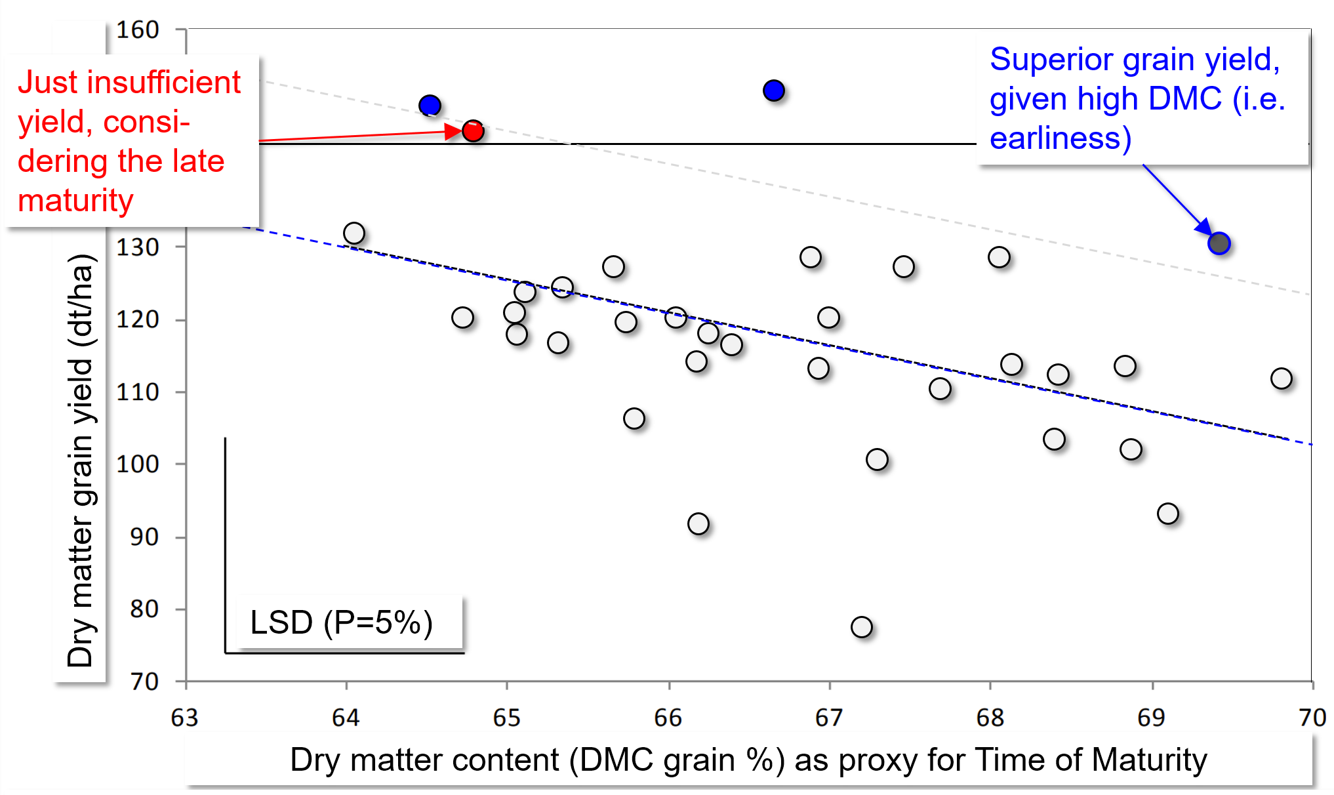
Early maturing (high DMC) maize tends to yield lower. Oftentimes, the so-called Maturity-Corrected Yield MCY is calculated and used for selection.
For selection, move the dashed regression line vertically to find the de-sired number of superior candidates (superior for maturity-corrected grain yield; ‚graphical regres-sion selection technique’).
Utz, Schnell, Singh, 1978: Maturity corrected yield (MCA) as a way to re-duce genotype-environ-ment interaction in maize trials. Cereal Research Communications 6, 399-404. www.jstor.org
stable/23779108.
Linear regression line between Grain Yield & DMC, employed as linear selection index, with all weight on yield yet correcting for DMC (Göttingen, 2013. PhD thesis Mareile Stever)

Slide 7
As we test candidate genotypes, we collect data (scores, measurements) for more than one trait. We rank candidates based on several trait simultaneously.
ISBN 0412753901
Selected fraction
Second Trait
First Trait
Linear Selection Index
Different from school reports, we have here these topics: Differences between phenotypic correlation and genetic correlation and between motivation during pre-breeding and motivation when cherry-picking the ultimate cultivar.
7

Slide 8
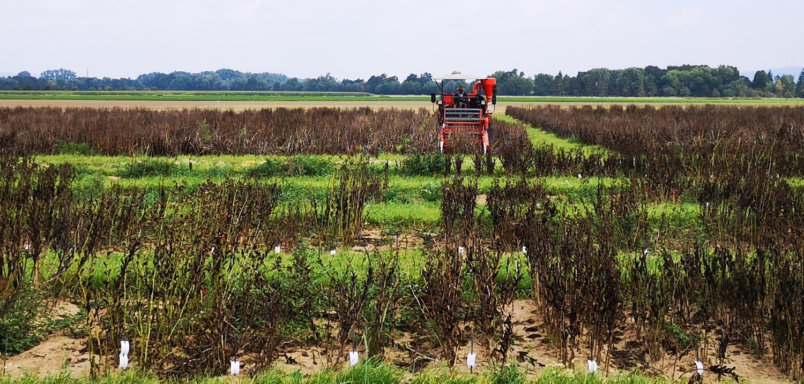
Selection indexes may differ, depending on actual purpose.
Select based on an index when working with candidate cultivars.
● Will an inferior performance in one trait be accepted by the farmer if there is an superior value at another trait in the cultivar? So, is there such compensation?
● From the agronomic, crop production perspective, what does the trade-off between traits look like?
ISBN 0412753901; DOI: 10.1201/9780429280498
Selected fraction
Second Trait
First Trait
(a )Linear Selection Index.
(b-d) are non-linear; contrasting purposes.
Index (d) hardly allows compensation. Only those who simultaneously exceed a threshold for both traits are selected. This may be appropriate in the final phase of selection among candidate cvs.
8

Slide 9
A Selection Index is an artificial trait, constructed to ease the selection for several traits.
Select based on an index when working in the pre-breeding phase (pilot breeding phase; recurrent selection phase)
● How can we avoid to loose alleles for superiority in all of the traits simultaneously?
● Is high performance in one trait a hindrance to high performance in another trait (due to genetic correlation, linkage, pleiotropy, allometry, other causes)?
ISBN 0412753901; DOI: 10.1201/9780429280498
Selected fraction
Second Trait
© SY
First Trait
(a ) Linear Selection Index.
(b-d) are non-linear; contrasting purposes.
Index (b) relies heavily on compensation. The supe-rior ones for the one or for the other trait are not discarded in any case.
9

Slide 10
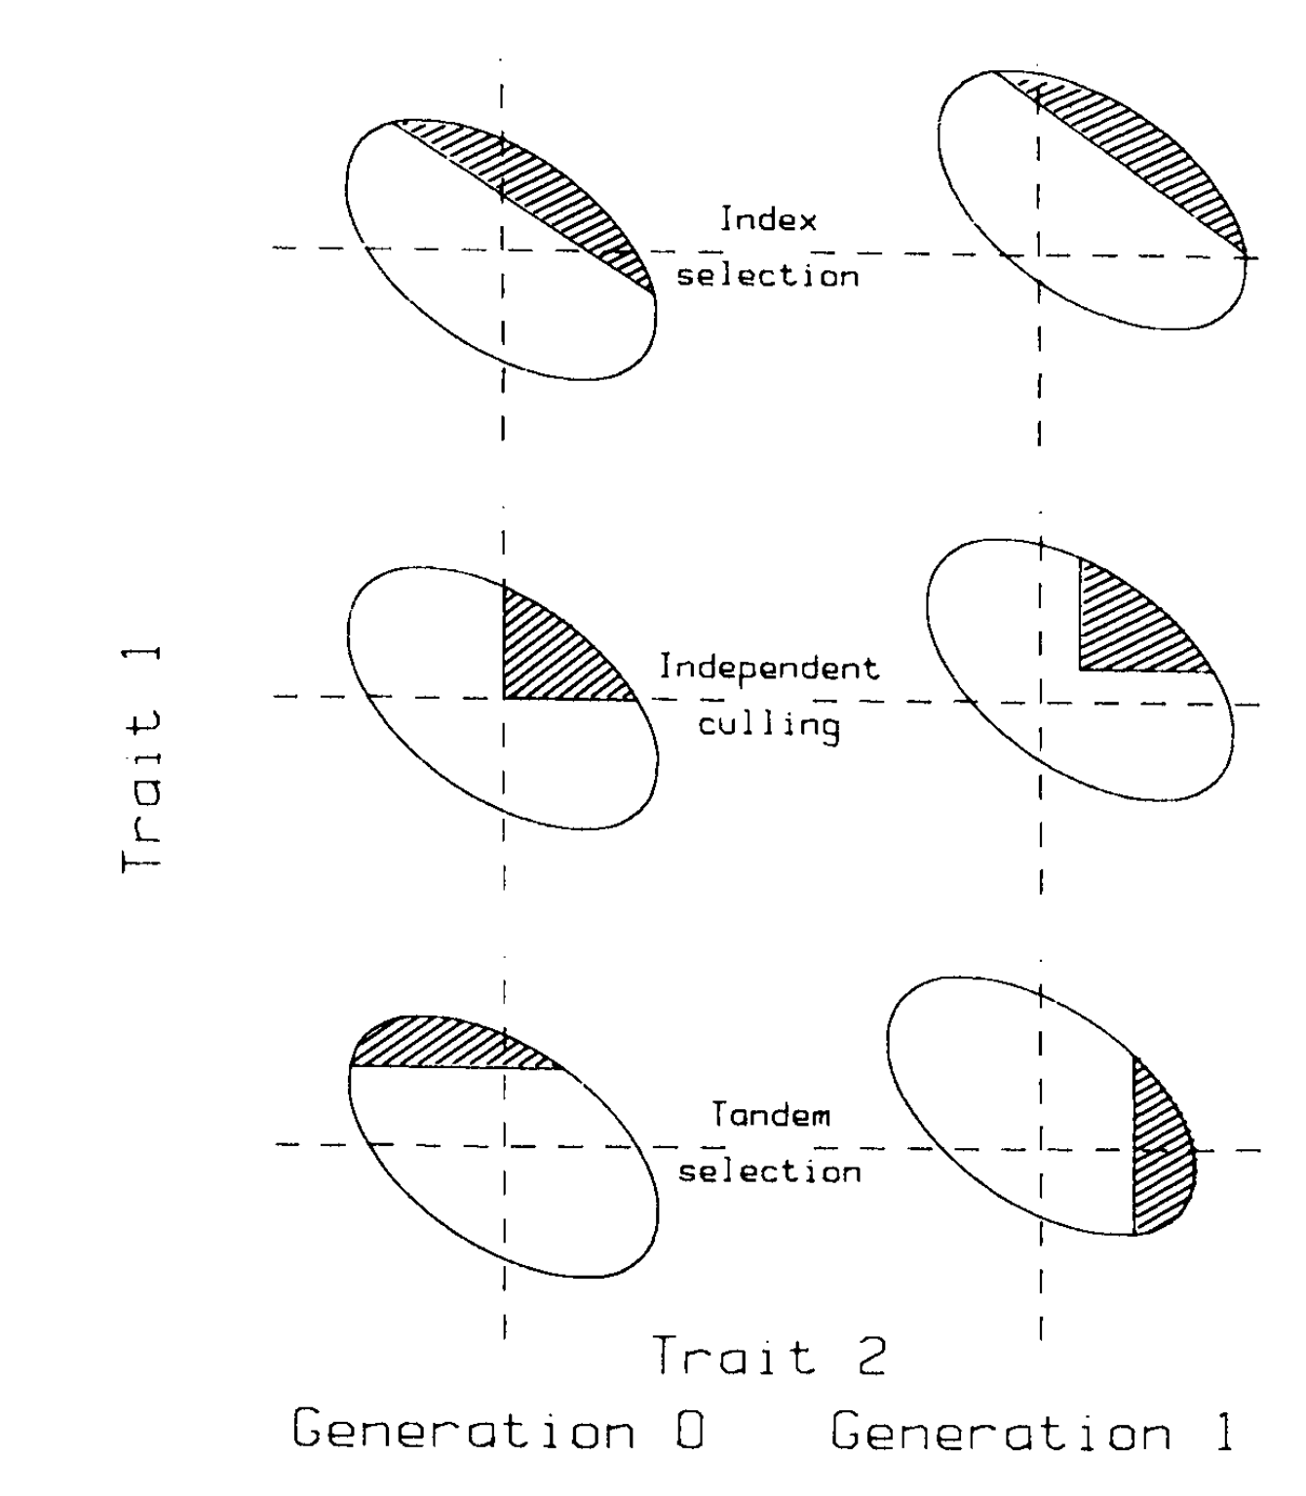
Instead of Index Seleciton: Tandem Selection; Independent Culling Selection.
Selection based on a Linear Selection Index.
Index = Artificial Trait. Typically, values of the ‘true’ traits are added, and a specific weight is given to each trait. For in-stance: Index = 3 ∙ Yield(t/ha) + 1∙Resistance (scale 1-9) + 1∙Quality (Scale 1-4) + ½ ∙ Earliness (scale 1-9).
Most famous is the so-called Optimum-Index: It maximizes the covariance of the index to the ‘aggregate economic value’ of the entries.
Independent Culling Selection (Selektion nach unabhängigen Grenzen).
Selection is focussed on the traits consecutively, one after the other. At first, you select superior entries for trait 1. Then, among these ‘winners’, you select for trait 2 (and so on). Hence, trait 2 is assessed only for the entries that were positively selected for trait 1 (save labour and money).
Tandem Selection
Selection is focussed – in one generation - on one trait only, and only in the next generation you select for another trait and so on (or for several generations on trait 1 and later on trait 2 ...; save labour and money).
DOI: 10.1201/9780429280498; Baker, 1986, 2019
Index Selection
Independent culling
Tandem Selection
10

Slide 11
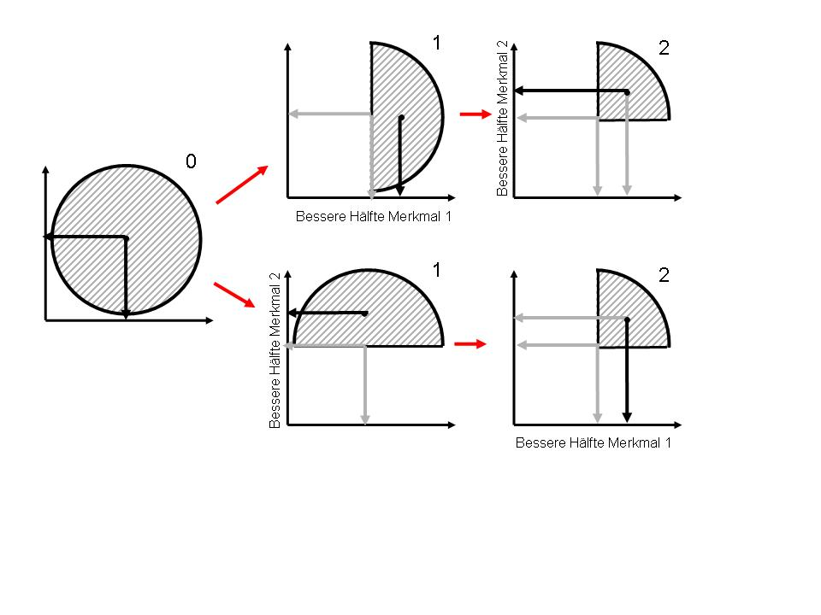
Tandem Selection. For which trait do you select in the first step? Uncorrelated traits.
We neglect season-specific conditions; in a wet season you can not select for drought tolerance etc ...; you see the point.
Imagine you have to find the ultimate best potato clone from a large number of potato clones (several seasons of testing). It is certain-ly very tempting to, in the first season, select for the cheapest and ‘simplest’ trait (e.g. time of maturity). The more expensive trait then only needs to be recorded for the selected part of the candidates in the next season(e.g. quality, yield) - saving labour and money.
Imagine that we are, instead, dealing with re-current mass selection. Then the number of candidates could be constant in each genera-tion (recombination/multiplication lies between the selection steps). Then you may have the same number of entries for each trait. It is now less obvious which trait to use for the first selection step (first season or phase or cycle).
Select for trait 2
Select for trait 1
Select for trait 2
Select for trait 1
11
Tandem Selection: Does it matter which trait is worked with first, and which trait is worked with second? Seemingly,
it does not matter, because the mean values (traits 1 and 2) for the finally selected group of entries are the same.

Slide 12
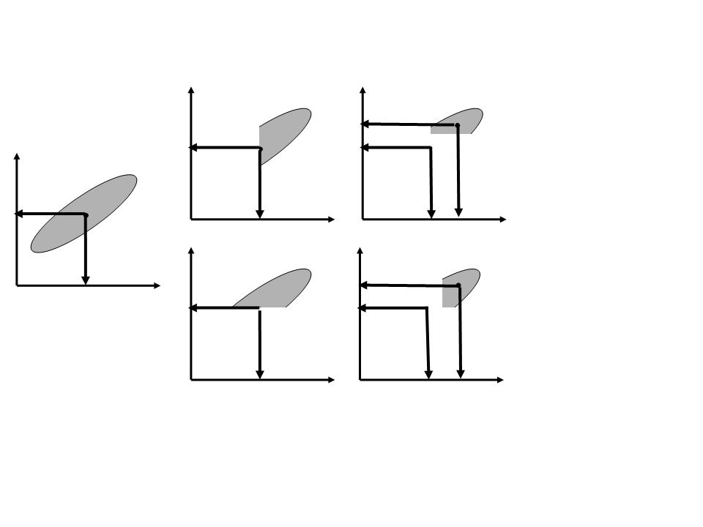
Tandem Selection. For which trait do you select in the first season (step)?
1
Traits are positively correlated.
Seemingly, it is irrelevant whether you chose to select first for trait 1 or first for trait 2.
2
0
Select for trait 2
Select for trait 1
1
2
Select for trait 2
Select for trait 1
Tandem Selection: Does it matter which trait is worked with first, and which trait is worked with second? In this case, with positive correlation and similar variation for both traits, it apparently does not matter:
The mean values (traits 1 and 2) for the finally selected group of entries are the seemingly (approx.) same.
12

Slide 13
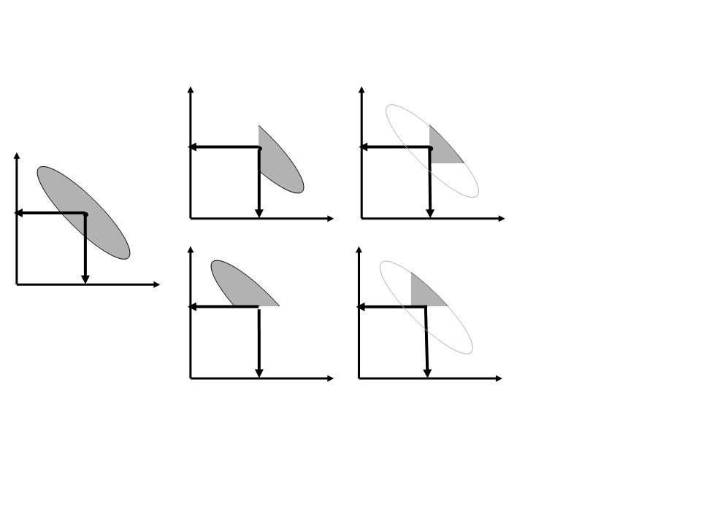
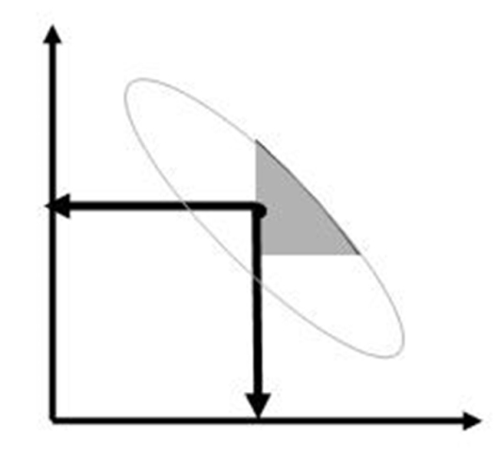
Now! Correlation is negative. If we select first for trait 1, the selected fraction will show a reduction in trait 2, which cannot be fully compensated for in the 2nd step.
1
2
Trait 2
Trait 2
Select for trait 2
0
Select for trait 2
Select for trait 1 first: higher gain for trait 1.
Select for trait 2 first:
Higher gain for trait 2.
Select for trait 1
1
2
Trait 1
Select for trait 2
Trait 1
Select for trait 1
It markedly matters, if traits are negatively correlated. What was exploited first gets the higher gain. If we first select for trait 1, then (1) we fully exploit that trait‘s variation and (2) reduce mean and variation in trait 2. The second step can, then, not compensate for that first loss.
13

Slide 14
Usually, ‘Index’ denotes the Smith-Hazel Optimum Index.
(Hazel L.N. 1943: The Genetic Basis for Constructing Selection Indexes.
Genetics 28:476–490)
There is a ranking of the selection approaches when selection for several traits ‘simultaneously’, ranking for efficiency and effectiveness.
Index Selection > Independent Culling > Tandem Selection
14

Slide 15
Again: With Index Selection, we calculate an index value I_{n} for each candidate n.
E.g.
First entry: I₁ = 3 ∙ Y₁ + 1∙R₁ + 1∙Q₁ + ½ ∙ E_{1;}
Second entry: I₂ = 3 ∙ Y₂ + 1∙R₂ + 1∙Q₂ + ½ ∙ E_{2;}
Third entry: I₃ = 3 ∙ Y₃ + 1∙R₃ + 1∙Q₃ + ½ ∙ E_{3;}
Y₁ would be the performance of entry 1 in trait Y,
R₁ would be the performance of entry 1 in trait R, et cetera.
I_{n} = b_{Y}Y_{n} + b_{R}R_{n} + b_{Q}Q_{n} + … for all entries, from first across the n^{th} until the last.
b: weight for the traits Y, R, Q, and so on.
So, a task is to find the appropriate b-value for each trait; to acknowledge
● the different economic values of the traits,
● differences in h²,
● potential correlations between the traits.
15

Slide 16

The default sophisticated Index, called ‘Optimum Index’, for three traits Y, R, Q, may look for candidate n like this:
I_{n} = b_{Y}Y_{n} + b_{R} R_{n} + b_{Q} Q_{n} + …
There are easier options.
Heritability-Index. For this, b=(a ∙ h²) for each trait.
The a-values is economic. Value per unit change in traits (€; $; £;¥; etc.). Use it if traits are not (or weakly) correlated.
Base-Index. For this, b=a. Use it if traits are not
(or weakly) correlated and if, moreover, h² of the traits
is very similar.
This maybe true in data from official trails. With, as usual, 2-3 years and
10-15 sites per year, r=4, good experiments, we expect h² of yield as
h²>0.8, and for most other traits h>0.9, hence, h² of all traits is high (hence similar).
You may as well use the base index if you assume that correlations are not zero and h²
is not the same for all traits, but you do not have trustworthy estimates of these values.

Slide 17
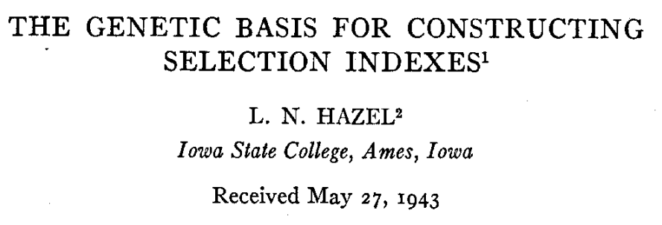
Back to the Optimum Index I_{n} = b_{Y}Y_{n} + b_{R}R_{n} + b_{Q}Q_{n} + …,
Find the correct or, rather, adequate, optimum b-value for each trait.
The so-called
Smith-Hazel-Optimum Index offers a
scientific approach for this issue.
DOI 10.1093/genetics/28.6.476
This approach needs and uses
estimates of Quantitative-Genetic
parameters such as h² and corre-
lations between traits.
17

Slide 18

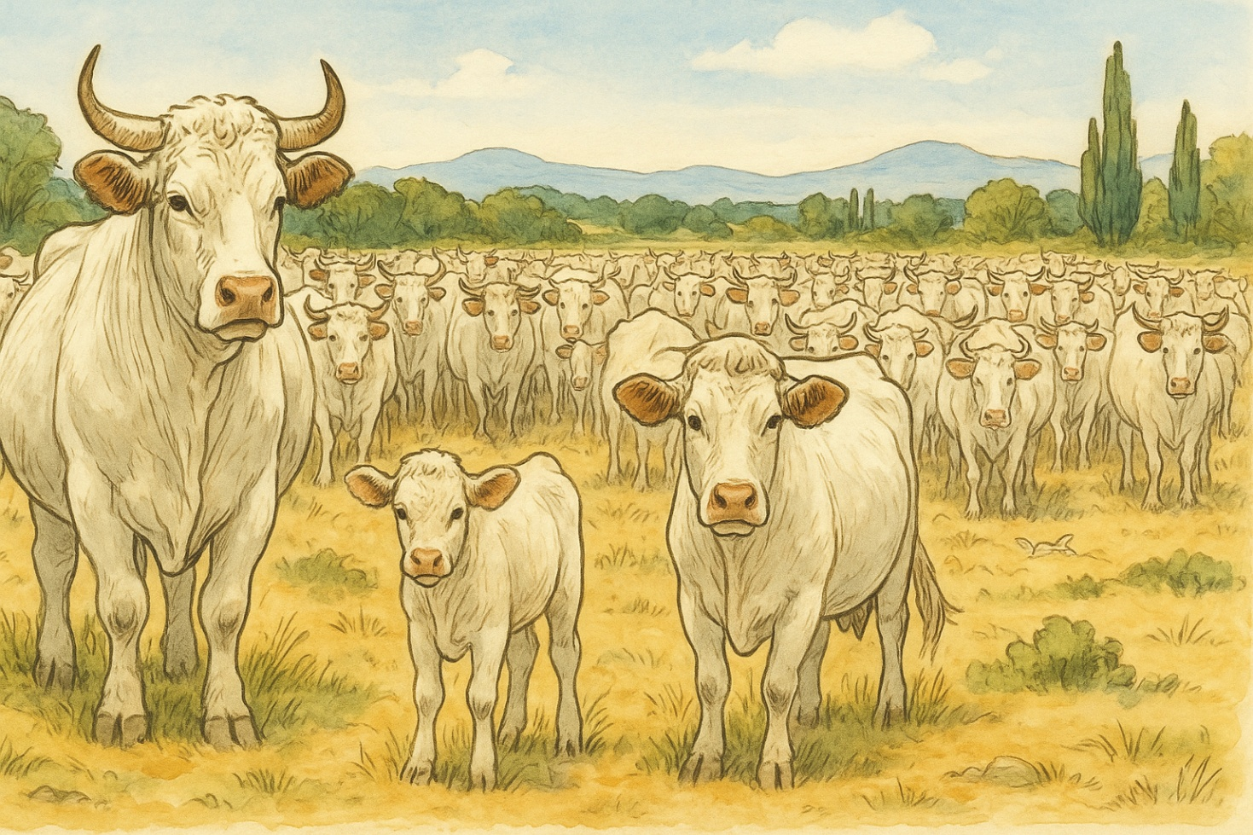
This approach uses estimates of Quantitative-Genetic parameters (h²; phenotypic and genetic variances and correlations between traits). These Population Parameters should change not or little over a certain period of time, otherwise the approach ‘im-plodes’. This approach is oftentimes fine for Animal Breeding, where races do gene-tically not change fast; and fine for some approaches in Plant Breeding, if we deal with large Populations and Germplasm which is not changing too fast.
18

Slide 19
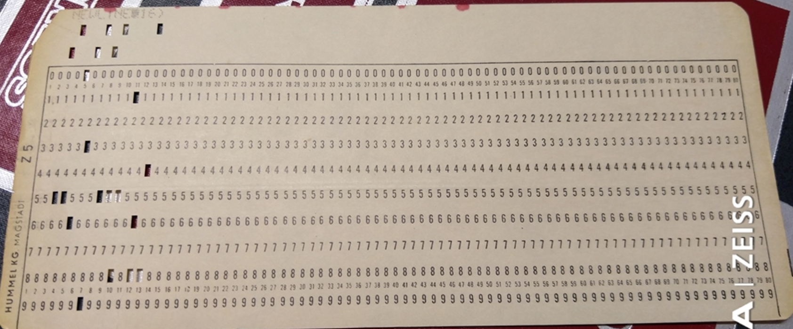
Accept the ‘existence’ of a genetic variance component; that share of the phenotypic variance which is due to genetic differences. Accept the ‘existence’ of a genetic covariance component between traits (cf. UNPLAB-CorrTraits_Ch-2[GenCorr]).
I_{n} = b₁Y_{n} + b₂R_{n} + b₃Q_{n} + …,
Find the b-value for each trait. The so-called Optimum Index (Smith, 1936; Hazel , 1943) offers an approach to find these b-values. With this index, candidate ranking is optimized to achieve improvement in the so-called aggregate value or economic value. Economic importance of traits, genetic correlation between traits and h² values of traits are taken into consideration here. To some extent we export our b-problem, since now ... where to find the economic a data? See last page ;-)
The b-values are derived by matrix calculation, based on:
Phenotypic variance-covariance matrix P, and on a
Genotypic variance-covariance matrix G, and on a
vector for the Economic values of traits a, and on a
vector for the Index weights b for each trait.
Pb = Ga => b = P⁻¹ G a
P⁻¹ is, by the way, the inverse of the matrix P (phenotypic variance-covariance matrix)
Punch card ;-), © W. Link
19

Slide 20
A first, easy application is, if the second trait is ‘only’ an auxiliary trait without economic importance – employed because of its correlation to the genuine trait
20

Slide 21

If the ‘further’ traits B,C, D, are all auxiliary traits (zero economic importance), then the genetic variance-covariance matrix is shortened and no economic value employed (all value is for the main trait A). Then calculations to get the b values are still easy.
Solve four equations for four unknown parameters. This could, given some patience, even be done without due matrix calculation ;-)
21

Slide 22
The Optimum Index to breed for earlier maturity with shortness as auxiliary trait.
The weight b for the main trait A is markedly larger than for the auxiliary trait B
(0.506 > 0.071).
This is because the auxiliary trait is not strongly correlated to A. For Plant Height, h² was markedly higher than h² of Maturity, otherwise Plant Height would be even less relevant as auxiliary trait. You see that the sign of the weight follows the sign of the correlation and the direction of the intended genetic change.
Again: Do not mix up (1) Indirect Selection for Trait A, where only Trait B is assessed, with (2) Index Selection, where both Trait A and Trait B are assessed, but Trait B is assigned zero economic weight.
22

Slide 23
Optimum Index, same genotypes, more and later experiments (environments)
With data from 3 years now (3 sites each) we see higher h² values. The main trait, Matu-rity, has h²>0.9. This leaves little room to get ‚help‘ from an auxiliary trait, especially since the correlation is low (about r=0.35). There-fore, the weight for the auxiliary trait is even weaker.
By the way, you see that the genetic corre-lation is now very simi-lar to the phenotyic correlation.
23

Slide 24

Optimum Index, same genotypes, more and later experiments (environments)
If such Optimum Index is any good, then it should predict the trait values of same genotypes in future years better than data of the direct trait (alone). Is that really the case? We can check it; here, in our experimental example. Of course, this is far from being proof, but it could be validated further in this way.
You see. Data on Maturity from year 1 is correlated with r=0.761 to data on Maturity from years 2-4, which is not bad, and which displays the h² of the Year 1 data. Yet. Data on this Index on Maturity from Year 1 data is slightly (indeed, only ;-) slightly) higher correlated to Maturity in the Years 2-4 (r=0.775). Hence, the Optimum Index slightly improved the prediction, even though weight for the auxiliary trait was weak.
By the way, the correlation between the Optimum Index for Maturity from Year 1 and the Optimum Index for Maturity from Year 2-4 was r = 0.781; even higher.
24

Slide 25
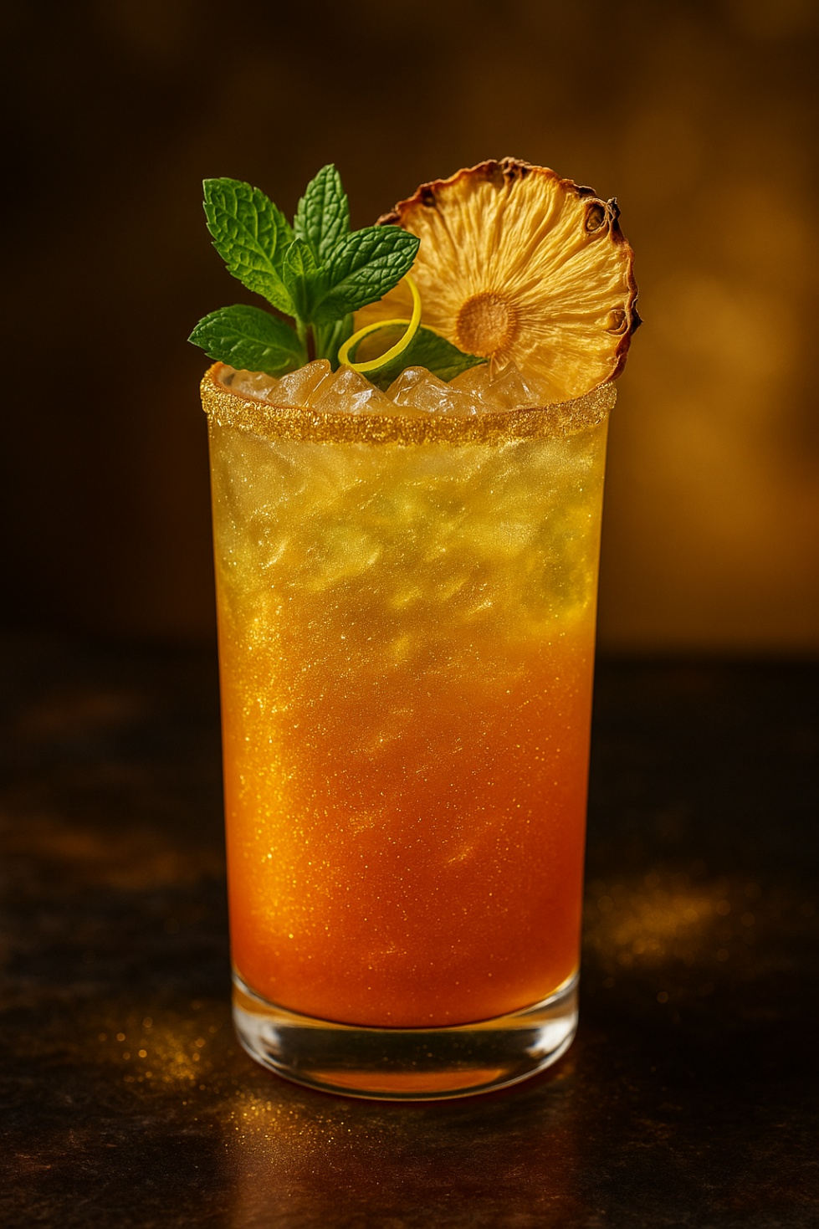
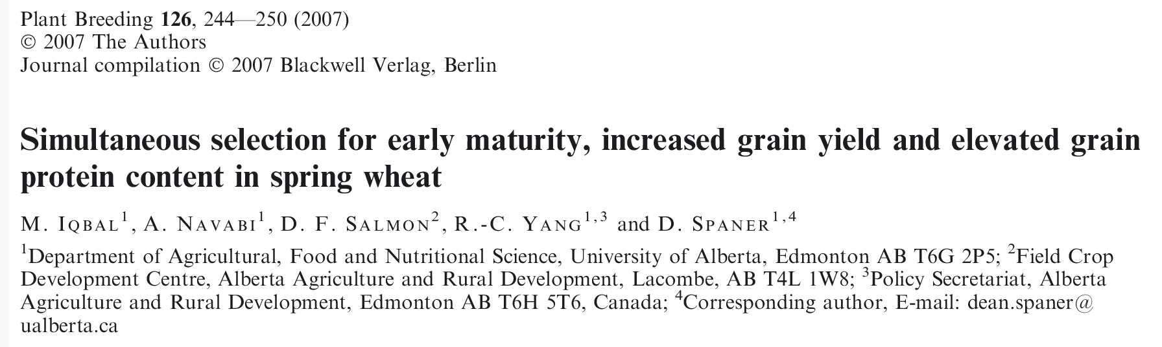
A Publication on this topic; and a refresher four you.
25

Slide 26
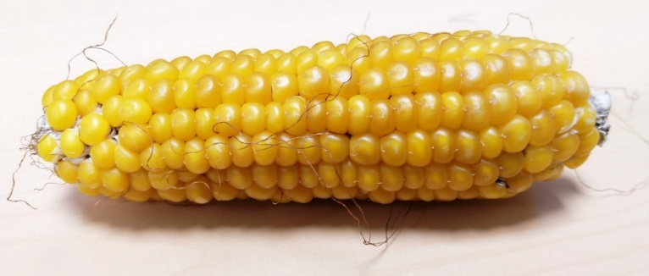
We studied this data in UNPLAB-Indirect_Ch-1[Correlated Gain].
What do we need to calculate an Optimum Index to maximize yield under organic conditions and using yield from conventional trials as auxiliary trait?
© WL
We may weigh the yield data from the organic field tests by 0.637 and the yield data form the con-ventional field tests by 0.125 to maximally improve yield under organic conditions and exploit the conventional data as auxiliary trait.
h² of organic trials was h²=0.674
h² of conv. trials was h²=0.655
r_{P} = 0.362
r_{G} = 0.498
26

Slide 27
This is the Algebra to include economic weights into the Index construction
© WL
P_{n}(A) = phenotypic trait A value of entry n
P_{n}(B) = phenotypic trait B value of entry n
27

Slide 28
This is the Algebra to include economic weights into the Index construction
If you have no experience in inverting matrices, you can also use these here ...
https://www.handymath.
com/cgi-bin/matrix7b.cgi
or https://www.
wolframalpha.com/
input?i=systems+of+equations+calculator
P b = G a => b = P⁻¹ G a
28

Slide 29
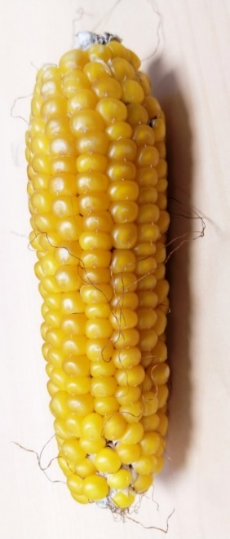
What if we employ economic weights for ‘Yield under Organic’ and ‘Yield under Conventional’? (1) Organic maize is 3% of all maize; (2) nevertheless a company may give e.g. equal weight to Organic and Conventional.
If organic with its share of ~3% of total maize acreage were consi-dered to be correspondingly mini-mal important, then we may even ask whether the additional effort in running such specific trials is really worth wile at all. Yet, if a company decides to consider nonetheless organic as equal valuable as con-vential, then in may be appropriate to run both types of trials and ac-cordingly weigh their results when selecting.
It is still up for debate whether we should then breed compromise types or rather run two separate programmes (organic and conventional).
29

Slide 30
What if we employ economic weights for ‘Yield under Organic’ and ‘Yield under Conventional’? (1) Organic maize is 3% of all maize; (2) nevertheless a company may give e.g. equal weight to Organic and Conventional.
If organic with its share of ~3% of total maize acreage were consi-dered to be correspondingly mini-mal important, then we may even ask whether the additional effort in running such specific trials is really worth wile at all. Yet, if a company decides to consider nonetheless organic as equal valuable as con-vential, then in may be appropriate to run both types of trials and ac-cordingly weigh their results when selecting.
It is still up for debate whether we should then breed compromise types or rather run two separate programmes (organic and conventional).
Re-try yourself to instead use the two econo-mic weights as a_{org}= a_{conv}=1 ...
30

Slide 31
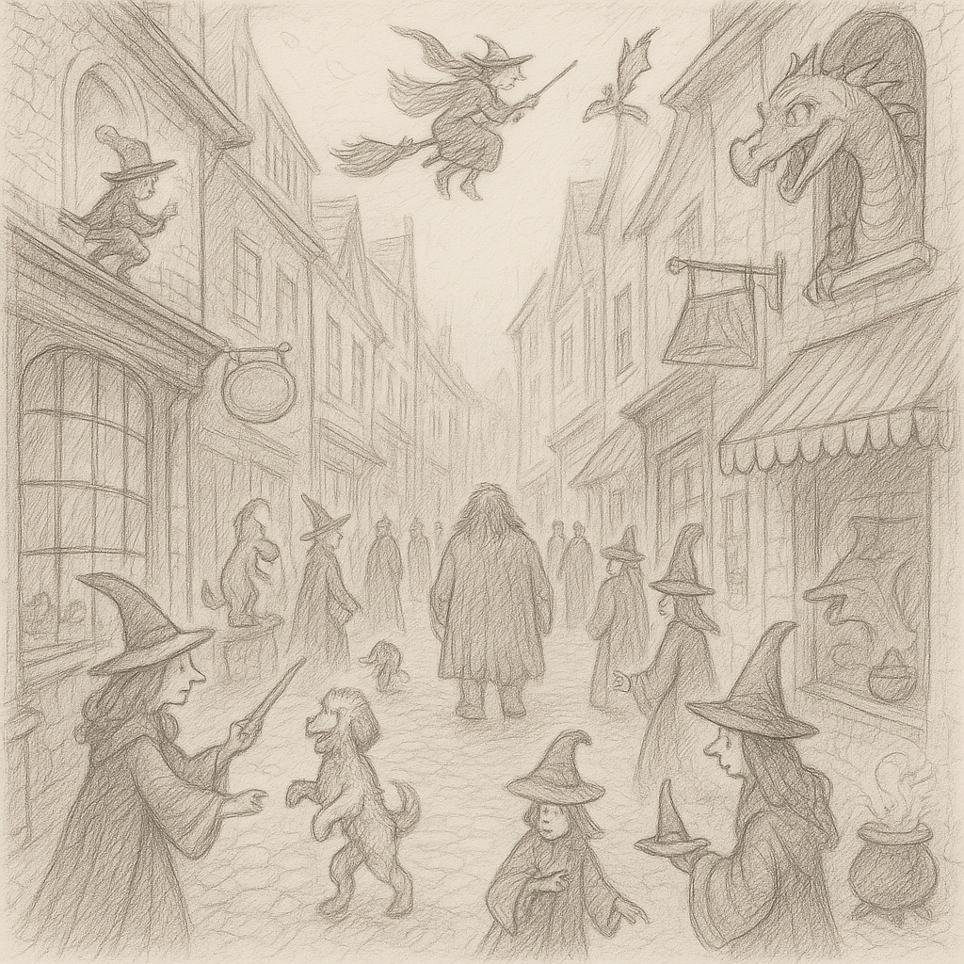
Again: A task is to find the appropriate economic value for each trait; to join it with data on phenotypic and genetic variances and covariances and to then, ultimately, maximize the correlation between the index values of the candidates and their ‘true value’ for further breeding and/or use in cultivar development.
Where to find these economic values?
This is mostly done by ... tradition and experience; or by .. gut instinct; or … uh huh …
there's a small, cluttered antique shop in a back alley of San
Francisco's Chinatown. There they sell such data.
Don't ask about the bronze rat ;-)
31

Slide 32
From here you may go to UNPLAB-QuGen_Ch-1[Teaser]
32
32

